Slide 1
NUMERICAL ANALYSIS
Lagrange
Interpolation
Polynomial reconstruction of cos(x), 1/(1+x²), and ln(x)·√x
Class Presentation

Slide 2
What is Interpolation?
Given a set of known data points (xᵢ, yᵢ), interpolation finds a function — usually a polynomial — that passes through every point exactly. We then use that polynomial to estimate the underlying function at intermediate values of x.
Key idea
Through n + 1 distinct points there is exactly one polynomial of degree ≤ n that passes through all of them.
Reconstruct
Estimate
Approximate
Recover a smooth curve from discrete measurements.
Predict values of f(x) between known sample points.
Replace a complicated f(x) with a simple polynomial.
Lagrange's method gives this polynomial in a closed, easy-to-evaluate form.
Lagrange Interpolation · Numerical Analysis
2

Slide 3
The Lagrange Formula
Given n + 1 data points (x₀, y₀), (x₁, y₁), …, (xₙ, yₙ):
P(x) = Σᵢ₌₀ⁿ yᵢ · Lᵢ(x)
Lᵢ(x) = Π (x − xⱼ) / (xᵢ − xⱼ) for all j ≠ i
1
Lᵢ(xᵢ) = 1
2
P(xₖ) = yₖ
3
Degree ≤ n
Each basis polynomial equals 1 at its own node and 0 at every other node.
Because of the property above, P(x) passes exactly through every data point.
P(x) is a polynomial of degree at most n — the lowest-degree fit through n+1 points.
In this project we use n + 1 = 4 nodes (degree 3 polynomial) for all three functions.
Lagrange Interpolation · Numerical Analysis
3

Slide 4
How the Method Works — A Tiny Example
Suppose we are given three points (0, 1), (1, 3), (2, 2). Find P(x).
Step 1 — Build the basis polynomials
Step 2 — Combine with y values
Step 3 — Verify
L₀(x) = (x−1)(x−2) / ((0−1)(0−2))
= (x−1)(x−2) / 2
L₁(x) = x(x−2) / ((1−0)(1−2))
= −x(x−2)
L₂(x) = x(x−1) / ((2−0)(2−1))
= x(x−1) / 2
P(x) = 1·L₀(x) + 3·L₁(x) + 2·L₂(x)
= (x−1)(x−2)/2 − 3x(x−2) + x(x−1)
= −1.5 x² + 3.5 x + 1
P(0) = 1 ✓
P(1) = −1.5 + 3.5 + 1 = 3 ✓
P(2) = −6 + 7 + 1 = 2 ✓
All three points satisfied.
This is exactly the procedure the C++ code performs — for any number of nodes, automatically.
Lagrange Interpolation · Numerical Analysis
4

Slide 5
C++ Implementation
Core Lagrange evaluator — works for any number of nodes:
double lagrange(const vector<double>& xn,
const vector<double>& yn,
double x) {
int n = xn.size();
double result = 0.0;
for (int i = 0; i < n; ++i) {
double Li = 1.0;
for (int j = 0; j < n; ++j) {
if (j == i) continue;
Li *= (x - xn[j]) / (xn[i] - xn[j]);
}
result += yn[i] * Li;
}
return result;
}
Notes
Two nested loops give O(n²) cost per evaluation.
No matrix solve needed — formula is direct.
Pure standard C++ — only <cmath> and <vector>.
Numerically stable for small n (we use n = 4).
Full source file (lagrange.cpp) is included with this submission.
Lagrange Interpolation · Numerical Analysis
5

Slide 6
Function 1 of 3
Function 1 — cos(x)
f(x) = cos(x) Interval: [0, π] Nodes: 4 (degree 3)
absolute error = |f(x) − P(x)| · relative error % = |f(x) − P(x)| / |f(x)| × 100
Interpolation nodes
Sample comparison: exact vs. interpolated
i | xᵢ | f(xᵢ)
0 | 0.0000 | 1.0000
1 | 1.0472 | 0.5000
2 | 2.0944 | -0.5000
3 | 3.1416 | -1.0000
x | f(x) exact | P(x) | abs error | rel error %
0.30 | 0.9553 | 0.9662 | 1.09e-02 | 1.1412
0.80 | 0.6967 | 0.7003 | 3.56e-03 | 0.5103
1.20 | 0.3624 | 0.3614 | 9.19e-04 | 0.2536
1.57 | 0.0000 | 0.0000 | 1.94e-08 | 0.5282
2.00 | -0.4161 | -0.4155 | 6.85e-04 | 0.1646
2.50 | -0.8011 | -0.8079 | 6.71e-03 | 0.8381
2.90 | -0.9710 | -0.9814 | 1.04e-02 | 1.0706
Max absolute error
Max relative error
1.09 × 10⁻²
1.1412 %
Lagrange Interpolation · Numerical Analysis
6

Slide 7
Function 1 of 3
Function 1 — cos(x) — Building P(x)
Step 1 Plug each node into the Lagrange basis
P(x) = (+1.0000) · L₀(x) + (+0.5000) · L₁(x) + (−0.5000) · L₂(x) + (−1.0000) · L₃(x)
where, with x₀=0, x₁=π/3, x₂=2π/3, x₃=π :
L₀(x) = (x−π/3)(x−2π/3)(x−π) / [(0−π/3)(0−2π/3)(0−π)]
L₁(x) = (x−0)(x−2π/3)(x−π) / [(π/3)(−π/3)(−2π/3)]
L₂(x) = (x−0)(x−π/3)(x−π) / [(2π/3)(π/3)(−π/3)]
L₃(x) = (x−0)(x−π/3)(x−2π/3) / [(π)(2π/3)(π/3)]
Step 2 Expand and collect — the cubic polynomial:
P(x) = +0.1451 x³ − 0.6839 x² + 0.0796 x + 1.0000
Note: All four node values match exactly: P(0)=1, P(π/3)=0.5, P(2π/3)=−0.5, P(π)=−1. The polynomial agrees with cos(x) at the nodes and only differs between them.
Lagrange Interpolation · Numerical Analysis
7

Slide 8
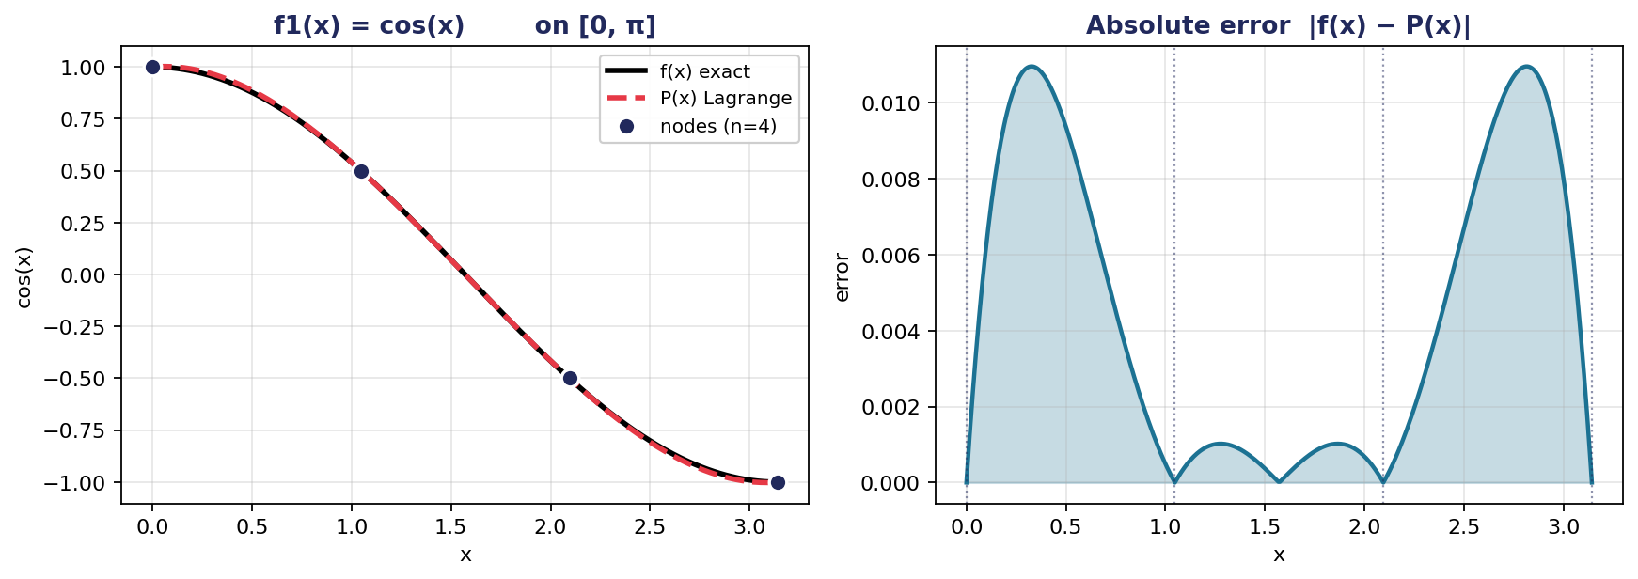
Function 1 of 3
Function 1 — cos(x) — Graph
Observation: cos(x) is smooth with bounded derivatives, so a degree-3 polynomial captures it well. Error stays under 1.1 % across the whole interval and is largest between nodes near the endpoints.
Lagrange Interpolation · Numerical Analysis
8

Slide 9
Function 2 of 3
Function 2 — 1 / (1 + x²) (Runge)
f(x) = 1 / (1 + x²) Interval: [-2, 2] Nodes: 4 (degree 3)
absolute error = |f(x) − P(x)| · relative error % = |f(x) − P(x)| / |f(x)| × 100
Interpolation nodes
Sample comparison: exact vs. interpolated
i | xᵢ | f(xᵢ)
0 | -2.0000 | 0.2000
1 | -0.6667 | 0.6923
2 | 0.6667 | 0.6923
3 | 2.0000 | 0.2000
x | f(x) exact | P(x) | abs error | rel error %
-1.80 | 0.2358 | 0.3052 | 6.94e-02 | 29.4178
-1.20 | 0.4098 | 0.5545 | 1.45e-01 | 35.2886
-0.60 | 0.7353 | 0.7040 | 3.13e-02 | 4.2560
0.00 | 1.0000 | 0.7538 | 2.46e-01 | 24.6154
0.60 | 0.7353 | 0.7040 | 3.13e-02 | 4.2560
1.20 | 0.4098 | 0.5545 | 1.45e-01 | 35.2886
1.80 | 0.2358 | 0.3052 | 6.94e-02 | 29.4178
Max absolute error
Max relative error
2.46 × 10⁻¹
35.2886 %
Lagrange Interpolation · Numerical Analysis
9

Slide 10
Function 2 of 3
Function 2 — 1 / (1 + x²) (Runge) — Building P(x)
Step 1 Plug each node into the Lagrange basis
P(x) = (+0.2000) · L₀(x) + (+0.6923) · L₁(x) + (+0.6923) · L₂(x) + (+0.2000) · L₃(x)
where, with x₀=−2, x₁=−2/3, x₂=+2/3, x₃=+2 :
L₀(x) = (x+2/3)(x−2/3)(x−2) / [(−2+2/3)(−2−2/3)(−2−2)]
L₁(x) = (x+2)(x−2/3)(x−2) / [(−2/3+2)(−2/3−2/3)(−2/3−2)]
L₂(x) = (x+2)(x+2/3)(x−2) / [(2/3+2)(2/3+2/3)(2/3−2)]
L₃(x) = (x+2)(x+2/3)(x−2/3) / [(2+2)(2+2/3)(2−2/3)]
Step 2 Expand and collect — the cubic polynomial:
P(x) = −0.1385 x² + 0.7538
Note: The y-values are symmetric (0.2, 0.6923, 0.6923, 0.2), so the cubic and linear terms cancel and the result reduces to a parabola. This explains the symmetric error pattern visible in the graph.
Lagrange Interpolation · Numerical Analysis
10

Slide 11
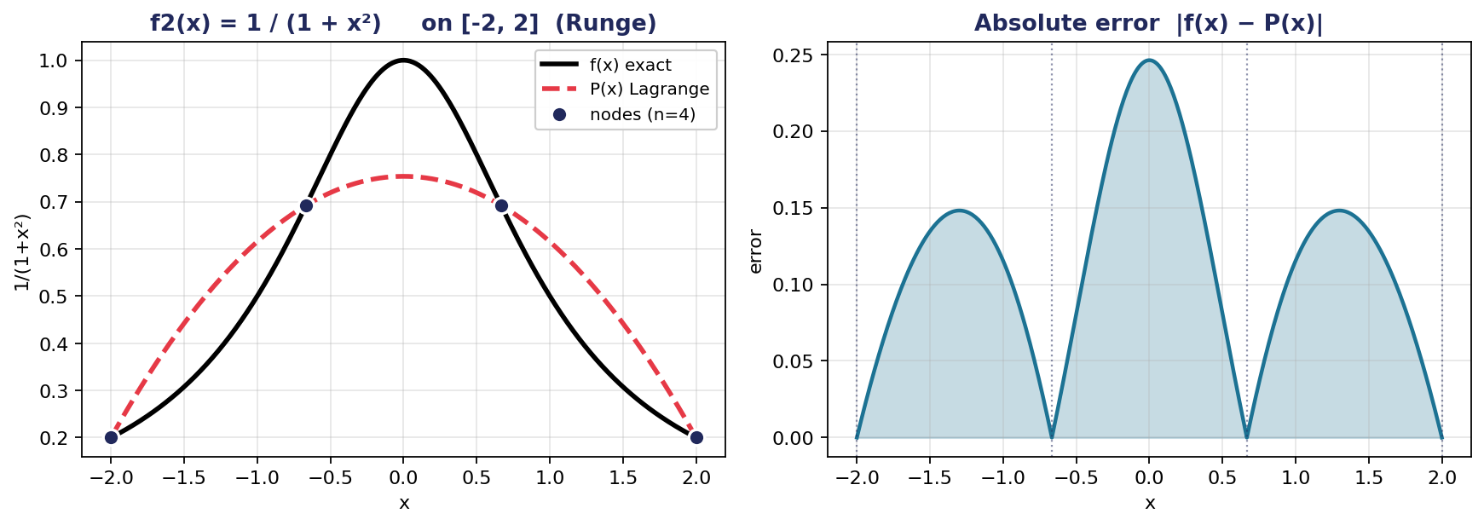
Function 2 of 3
Function 2 — 1 / (1 + x²) (Runge) — Graph
Observation: Runge's phenomenon: even though the function is perfectly smooth, equally-spaced nodes give a poor fit. The polynomial misses the central peak by 25 % and oscillates with errors above 35 % near the middle. A classic warning against blindly adding more equally-spaced nodes.
Lagrange Interpolation · Numerical Analysis
11

Slide 12
Function 3 of 3
Function 3 — ln(x) · √x
f(x) = ln(x) · √x Interval: [1, 5] Nodes: 4 (degree 3)
absolute error = |f(x) − P(x)| · relative error % = |f(x) − P(x)| / |f(x)| × 100
Interpolation nodes
Sample comparison: exact vs. interpolated
i | xᵢ | f(xᵢ)
0 | 1.0000 | 0.0000
1 | 2.3333 | 1.2943
2 | 3.6667 | 2.4879
3 | 5.0000 | 3.5988
x | f(x) exact | P(x) | abs error | rel error %
1.30 | 0.2991 | 0.3009 | 1.76e-03 | 0.5880
1.80 | 0.7886 | 0.7896 | 1.03e-03 | 0.1309
2.40 | 1.3563 | 1.3562 | 7.68e-05 | 0.0057
3.00 | 1.9029 | 1.9026 | 2.87e-04 | 0.0151
3.60 | 2.4304 | 2.4304 | 3.27e-05 | 0.0013
4.20 | 2.9410 | 2.9412 | 1.78e-04 | 0.0060
4.70 | 3.3550 | 3.3552 | 1.30e-04 | 0.0039
Max absolute error
Max relative error
1.76 × 10⁻³
0.5880 %
Lagrange Interpolation · Numerical Analysis
12

Slide 13
Function 3 of 3
Function 3 — ln(x) · √x — Building P(x)
Step 1 Plug each node into the Lagrange basis
P(x) = (+0.0000) · L₀(x) + (+1.2943) · L₁(x) + (+2.4879) · L₂(x) + (+3.5988) · L₃(x)
where, with x₀=1, x₁=7/3, x₂=11/3, x₃=5 :
L₀(x) = (x−7/3)(x−11/3)(x−5) / [(1−7/3)(1−11/3)(1−5)]
L₁(x) = (x−1)(x−11/3)(x−5) / [(7/3−1)(7/3−11/3)(7/3−5)]
L₂(x) = (x−1)(x−7/3)(x−5) / [(11/3−1)(11/3−7/3)(11/3−5)]
L₃(x) = (x−1)(x−7/3)(x−11/3) / [(5−1)(5−7/3)(5−11/3)]
Step 2 Expand and collect — the cubic polynomial:
P(x) = +0.0013 x³ − 0.0371 x² + 1.0832 x − 1.0474
Note: The cubic coefficient is tiny (0.0013), confirming that ln(x)·√x is nearly linear on [1, 5]. P(x) behaves almost like a straight line, which is why the fit is so accurate.
Lagrange Interpolation · Numerical Analysis
13

Slide 14
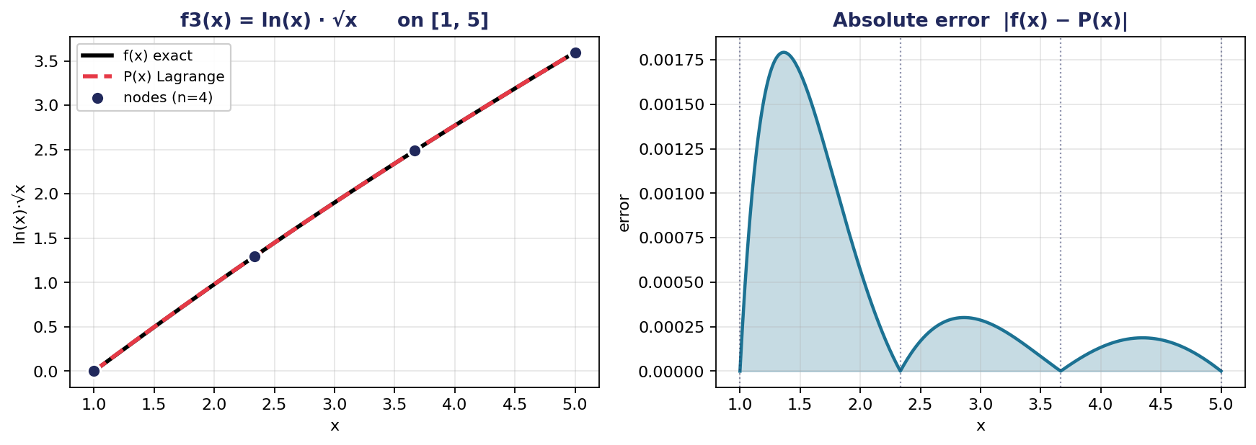
Function 3 of 3
Function 3 — ln(x) · √x — Graph
Observation: ln(x)·√x grows almost linearly on [1, 5], so a cubic polynomial fits very closely. The maximum relative error is below 0.6 %, concentrated near x = 1 where the log term is most curved.
Lagrange Interpolation · Numerical Analysis
14

Slide 15
Error Comparison Across All Three Functions
What this tells us
cos(x)
Smooth, bounded derivatives → polynomial fit works very well even with just 4 nodes.
1/(1+x²) — Runge
Smooth but with a sharp peak. Equally-spaced nodes badly under-fit the middle. 35 % relative error.
ln(x)·√x
Nearly linear shape on [1,5] → cubic interpolation is almost exact (< 0.6 %).
Lagrange Interpolation · Numerical Analysis
15

Slide 16
Conclusions
01
Lagrange's formula always works
02
Accuracy depends on the function
Through any n + 1 distinct points there is exactly one polynomial of degree ≤ n. The formula gives it directly, no linear system required.
Smooth, well-behaved functions (cos, ln·√x) are interpolated to under 1 % error with just 4 nodes.
03
More nodes ≠ always better
04
Practical takeaway
The Runge function shows that equally-spaced nodes can produce 35 % error and increasing n makes it worse. This motivates Chebyshev nodes and spline methods.
Lagrange interpolation is simple, exact at the nodes, and ideal for low-degree fits. Know its limitations before applying it to peaked or oscillating data.
Thank you · Questions?

